Slide 1
Python Workshop
Feb 2015

Slide 2
Brief History
Created in the Netherlands, 1989 by Guido van Rossum
Named after Monty Python
Open sourced from the beginning
Considered a scripting language, but is much more
Scalable, object oriented and functional from the beginning
Used by Google from the beginning

Slide 3

Python’s Benevolent Dictator For Life
“Python is an experiment in how much freedom programmers need. Too much freedom and nobody can read another's code; too little and expressive-ness is endangered.”
Guido van Rossum

Slide 4
Where is it being used?

Slide 5
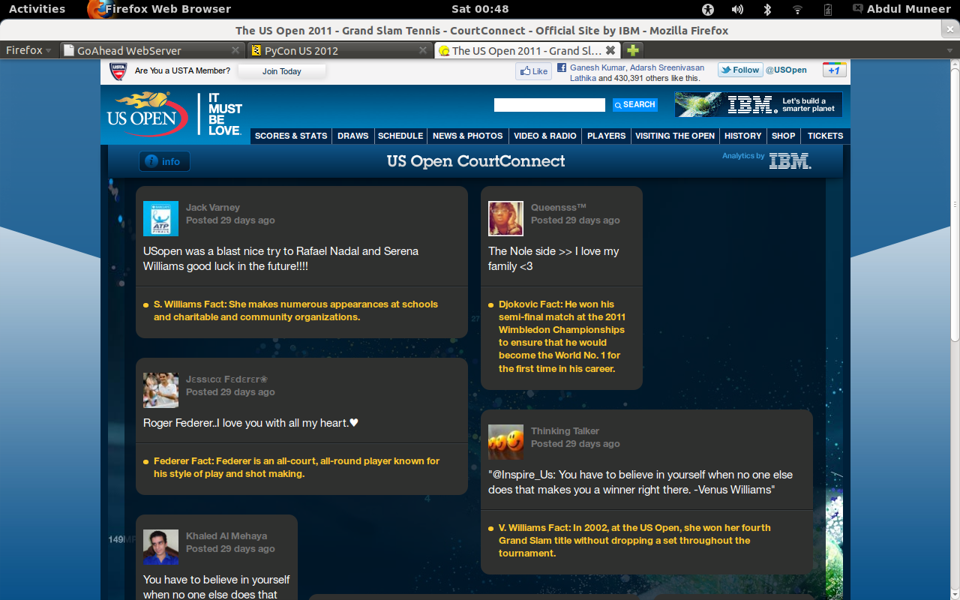
Python in action..

Slide 6
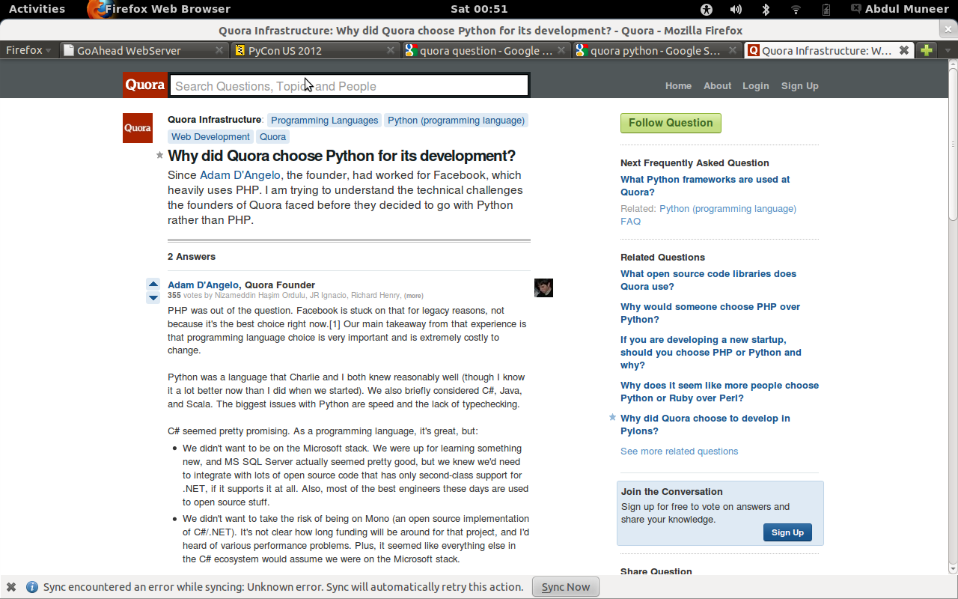
Python in action..

Slide 7

Python in action..

Slide 8
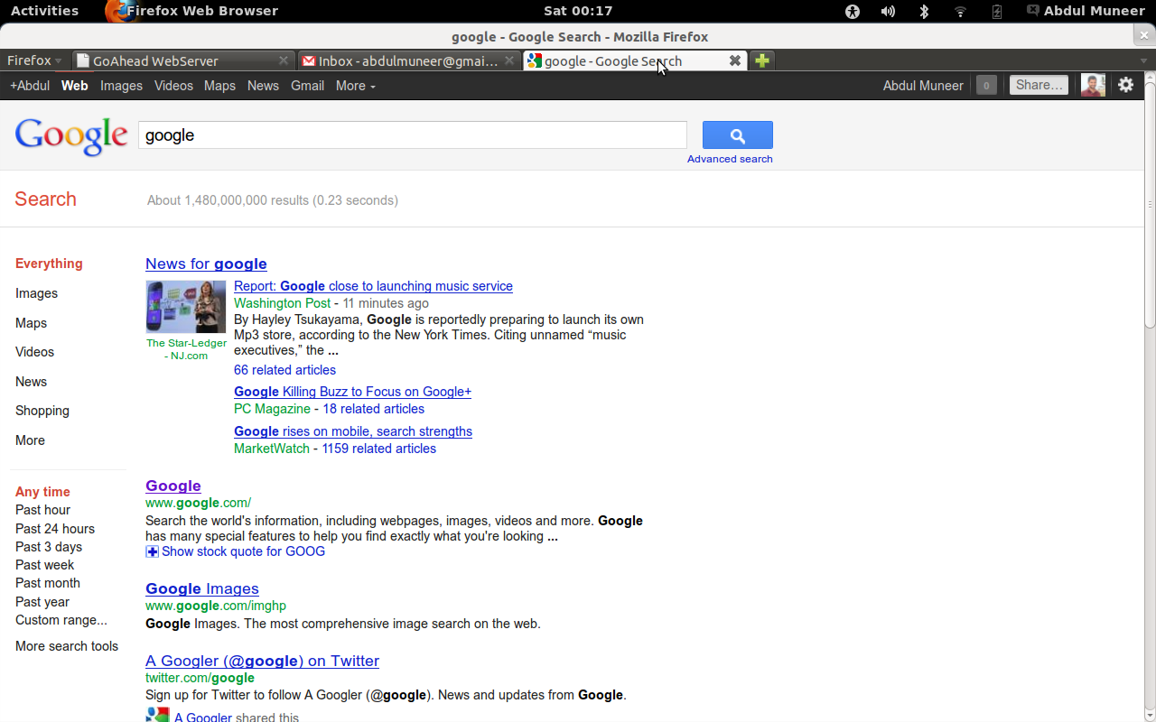
Python in action..

Slide 9
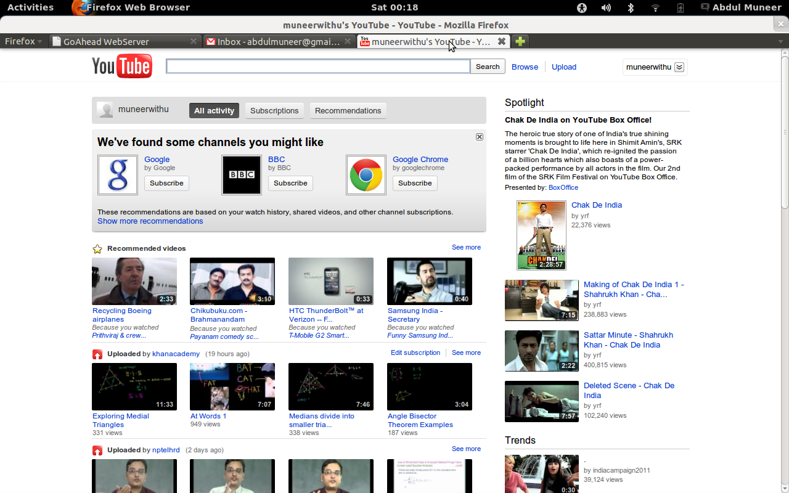
Python in action..

Slide 10
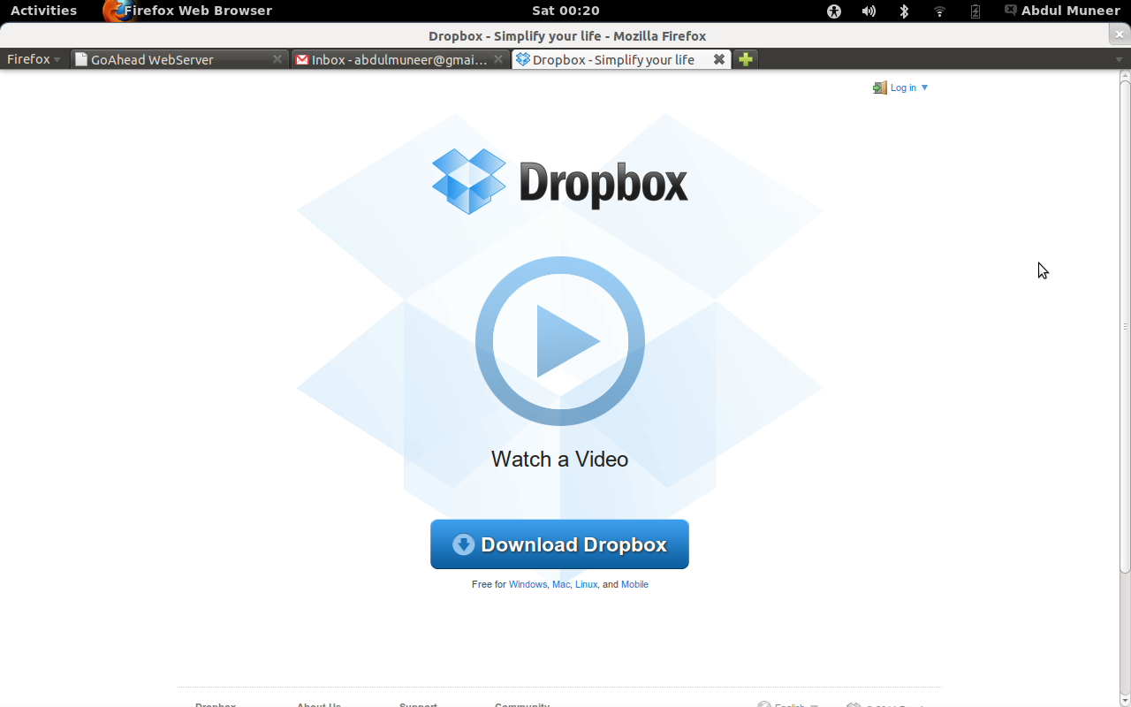
Python in action..

Slide 11
And many many more...

Slide 12
What is Python?
Interpreted
Interactive
Portable
Functional
Object-Oriented
programming language

Slide 13
Why is Python Special?
Productivity
Ease of Learning
Readability (hence maintainability)
Interacrive Console
Community
Batteries included!

Slide 14
Productivity
Dropbox has seen amazing growth since it launched in September 2008 and by end of 2011 they had:
  - 25M people registered on Dropbox
  - More than 1M files saved every 5 min
  - 200M files saved daily
  - Users in 175 countries
  - Dropbox in five languages: English, Spanish, French, German and Japanese
Dropbox was fewer than 70 people at that time!

Slide 15
The Zen of Python
Beautiful is better than ugly.
Explicit is better than implicit.
Simple is better than complex.
Complex is better than complicated.
Flat is better than nested.
Sparse is better than dense.
Readability counts.
Special cases aren't special enough to break the rules.
Although practicality beats purity.
Errors should never pass silently.
Unless explicitly silenced.
In the face of ambiguity, refuse the temptation to guess.
There should be one-- and preferably only one --obvious way to do it.
Although that way may not be obvious at first unless you're Dutch.
Now is better than never.
Although never is often better than *right* now.
If the implementation is hard to explain, it's a bad idea.
If the implementation is easy to explain, it may be a good idea.
Namespaces are one honking great idea -- let's do more of those!

Slide 16
Beauty of Architecture
Python incorporates so many design patterns so tht you don't have to..
e.g.: iterators, generators..
print sorted(set('abracadabra'))

Slide 17
Core Python
Syntax:
Looping/Conditional constructs
Data Types
Functions
Class
Batteries..

Slide 18
Syntax
Code blocks are indented
No semicolons please... :)
Follow PEP 8 to be respected..
# commented line
'''
block comments
'''
Case Sensitive!

Slide 19
Data Types
-int ,
-string 'like this' or “this”
-list [1,2,3]
-tuple (1,2,3)
-dict {'Oh' : 'My!'}
  (dictionary is rockstar data type!! )
-set ([ 1,2,3 ])
True, False, None

Slide 20
Data Types
Pass by reference!
id
type
Garbage collection: reference count

Slide 21
Operations
Arithmetic: _,+,/, *, ==, !=, <, >
Logical: and, or, is, in
Assignment: =

Slide 22
Functions
def validate_points(start_latlng,stop_latlng):
#validate starting cordinates
try:
gmaps.latlng_to_address(*start_latlng)
except:
output_message = 'Geolocation Error. Unable to locate the start address'
return([False,output_message])

Slide 23
More on Functions
-range()
-abstractions! Decorator
-map, filter, reduce
  -list comprehension kicks ass..
Functions are first class objects

Slide 24
Class
class SelfDrive(object):
def __init__(self,start_latlng = None, stop_latlng = None):
#def __init__(self,start_latlng = (30.29, -97.7), stop_latlng = (37.9, -122.3)):
self.start_latlng, self.stop_latlng = start_latlng, stop_latlng
self.gmaps = GoogleMaps()
self.verify_passed, self.verify_message = self.validate_points(self.start_latlng,self.stop_latlng)
self.directions = self.gmaps.directions(self.start_latlng, self.stop_latlng) \
if self.verify_passed else None
self.cost_incured = 0
def validate_points(self,start_latlng,stop_latlng):
#validate starting cordinates
try:
self.gmaps.latlng_to_address(*start_latlng)
except:
output_message = 'Geolocation Error. Unable to locate the start address'
return([False,output_message])

Slide 25
Batteries
Aka important modules..
-sys
-os
-subprocess
-time
-datetime
-urllib
-threading

